Slide 1

Majorization Minimization Algorithms
Ganzhao Yuan

Slide 2
Outline
Basic (Convexity, Continuity, Nonsmooth)
Majorization Minimization Algorithms
Applications in Algorithm Design
Lipschitz Gradient Descent
Proximal Gradient Descent
Quadratic Surrogate
Convex Function Surrogate
DC Programming Surrogate
Variational Surrogate
Cubic Approximation
Linear/ Majorized ADMM

Slide 3
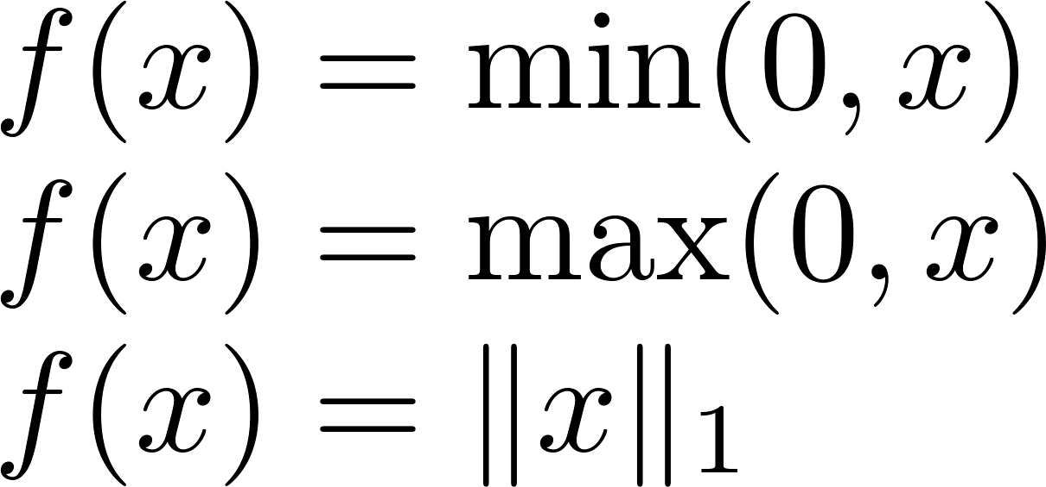
Convex Function
Nonsmooth
envelop function, norm function:

Slide 4
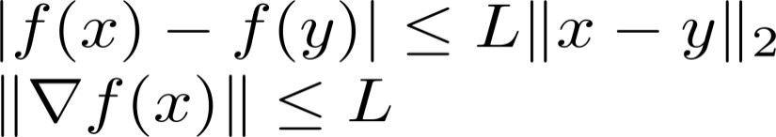
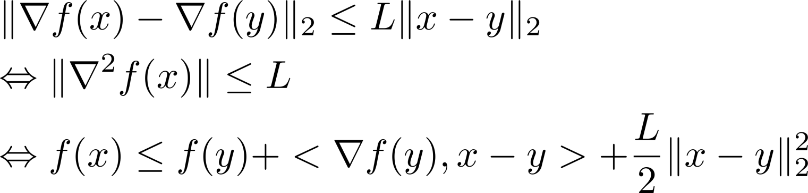
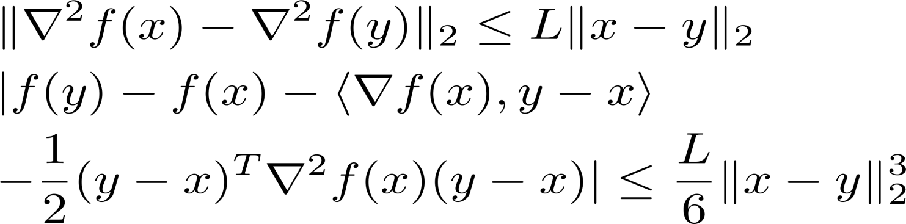
Continuity
Lipschitz Continuity
Gradient Lipschitz Continuity
Hessian Lipschitz Continuity

Slide 5
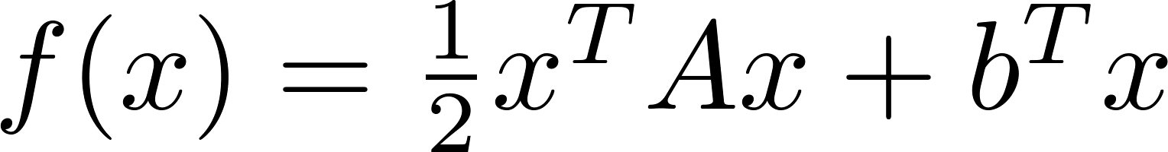
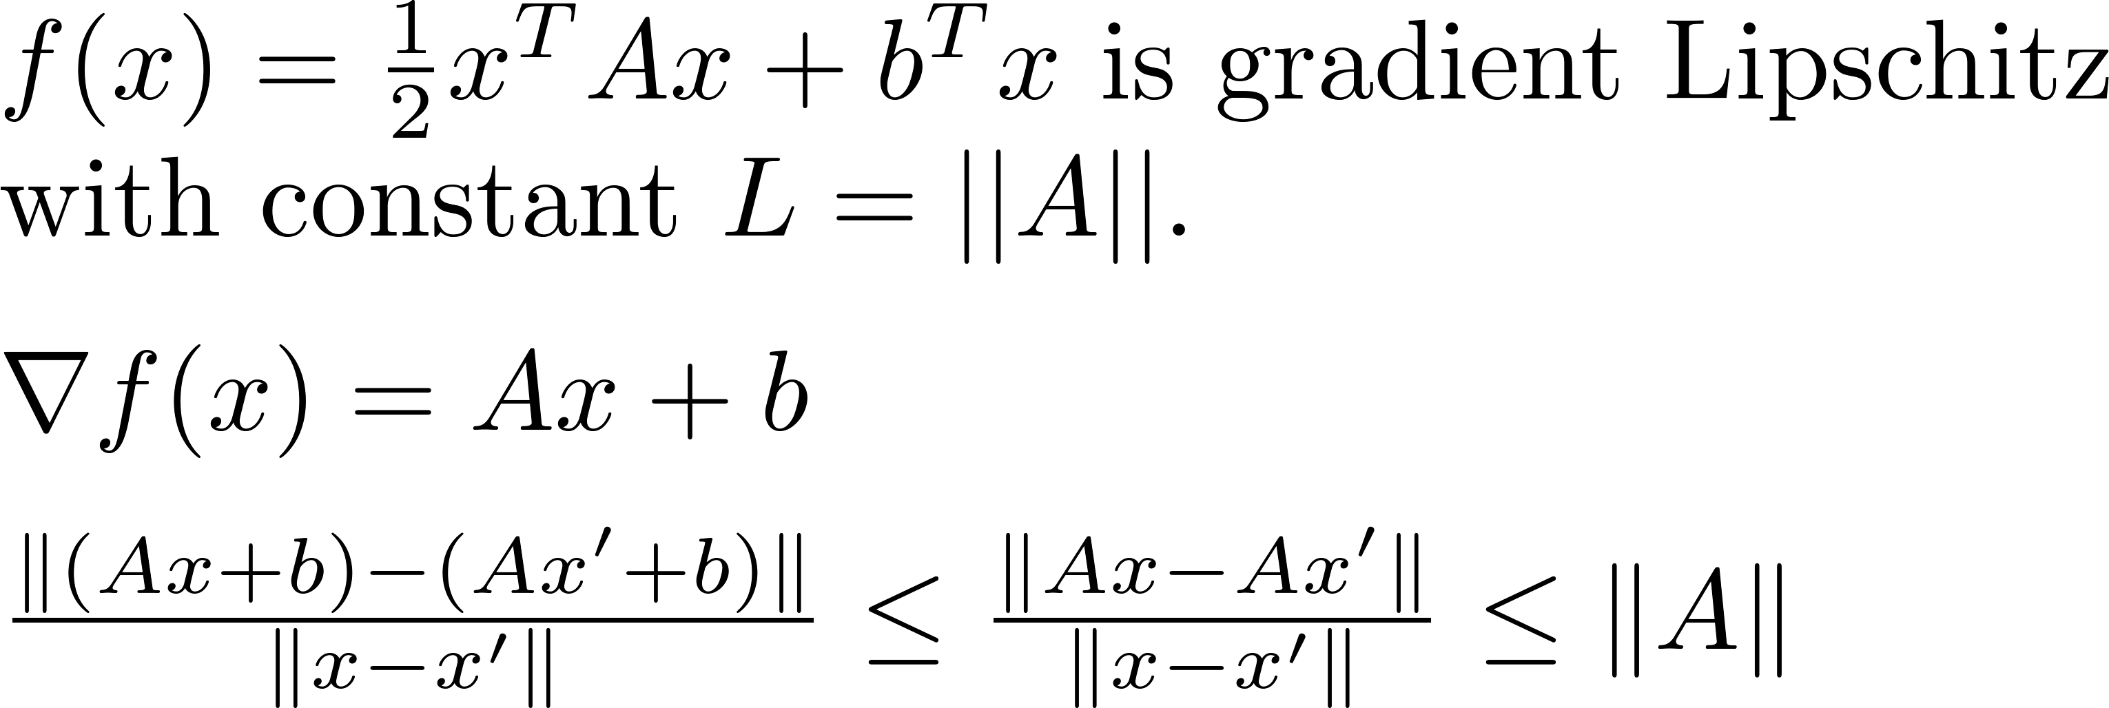
Example:

Slide 6
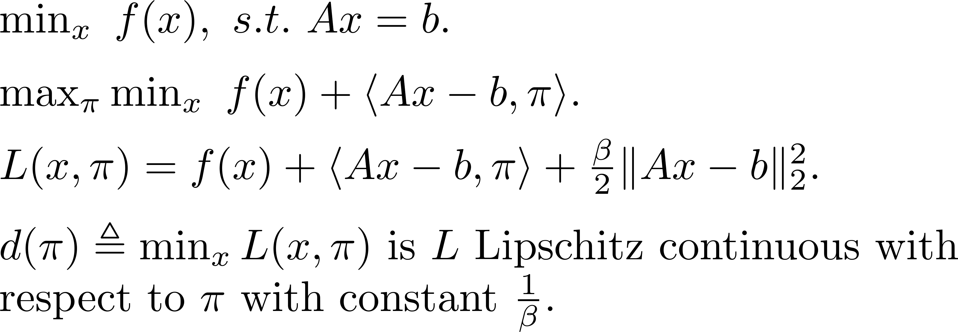
Example: augmented Lagragian function

Slide 7
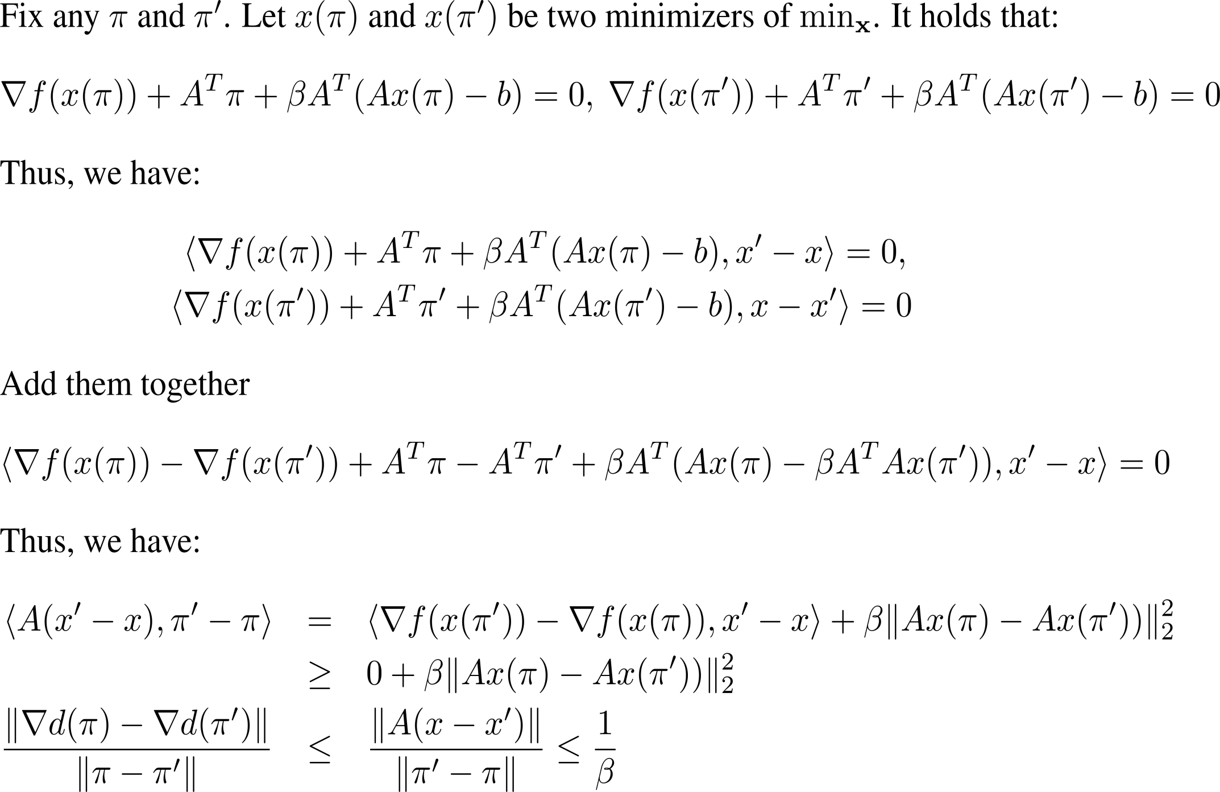
Proofs

Slide 8
Majorization Minimization Algorithms

Slide 9
Overview of the MM Algorithm
MM algorithm is not an algorithm, but a principle for constructing optimization algorithms
MM algorithm operates by creating a surrogate function that majorizes the objective function. When the surrogate function is optimized, the objective function is driven downhill as needed.

Slide 10
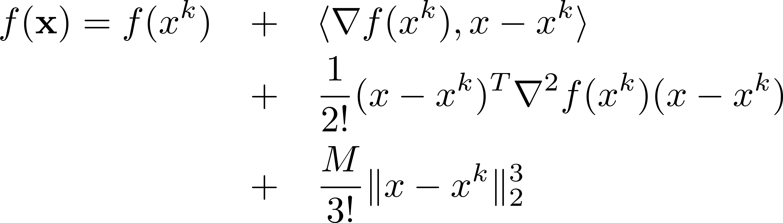
Iterative Optimization

Slide 11
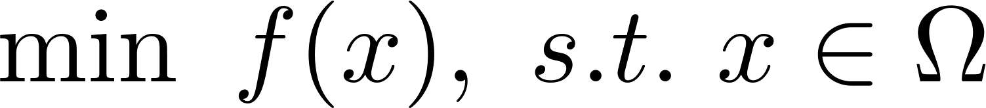

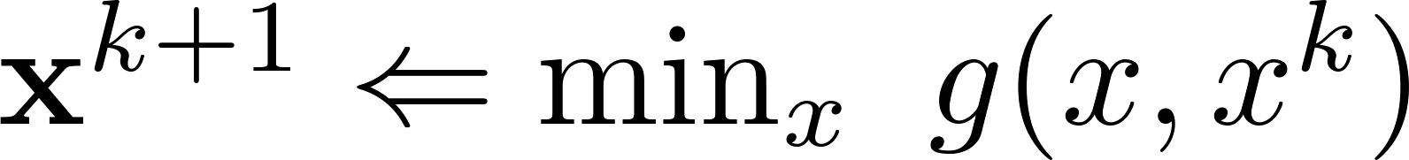

Majorization Minimization
Optimization Problem
The objective function is too complicated to manipulate
Idea: Successively minimize an approximating function , hopping the sequence of minimizers will converge to the optimal solution
Question: how to construct ?

Slide 12
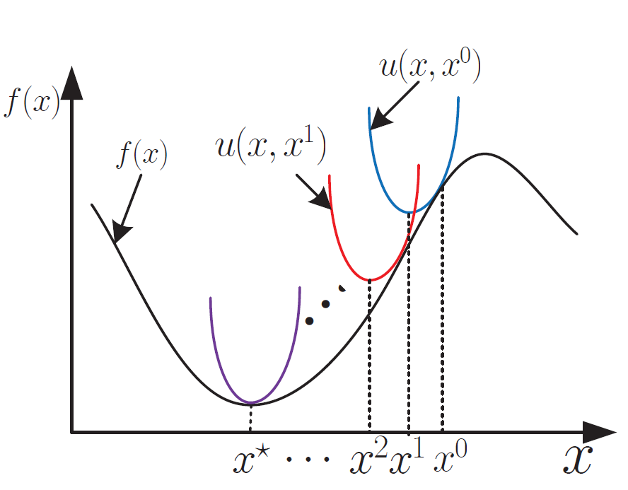
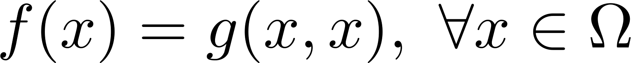
Majorization Minimization
1. Dominancy Condition:
2. Tangency Condition
Key Property:

Slide 13
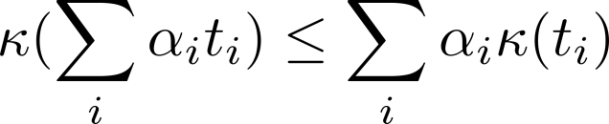
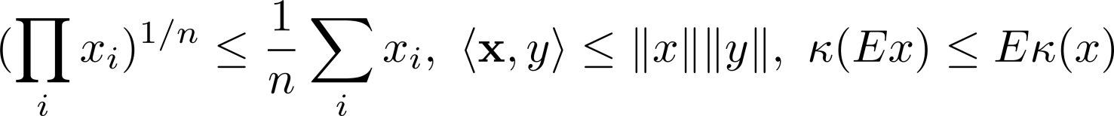
Construct Surrogate Function
Jensen's inequality
Convexity inequality
Cauchy–Schwarz inequality
Inequality of arithmetic and geometric means
Notes:
Very useful in log exp family funciton

Slide 14
Applications in Algorithm Design

Slide 15
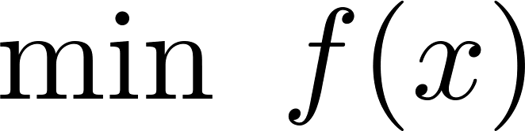
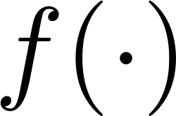
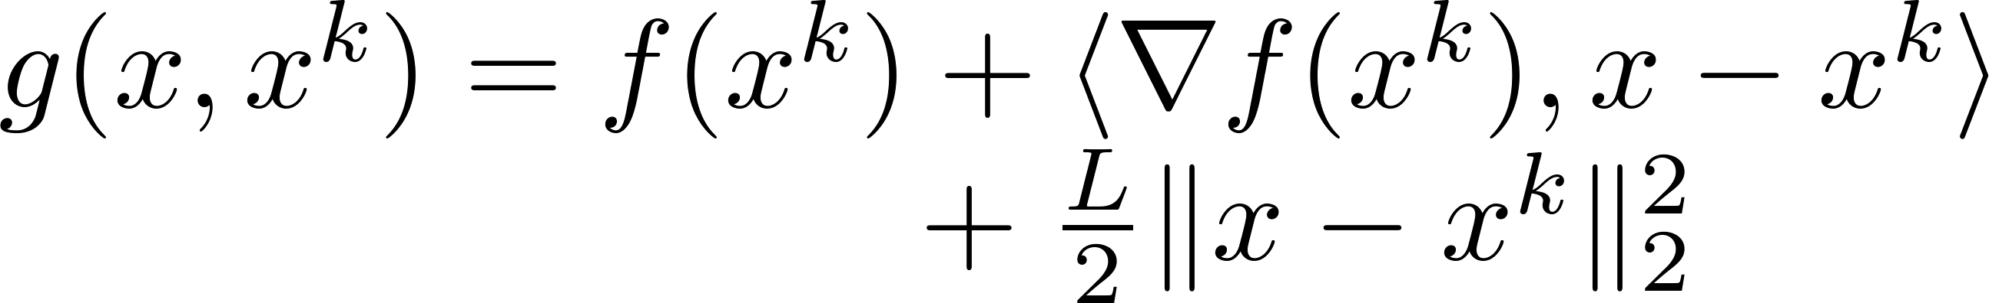
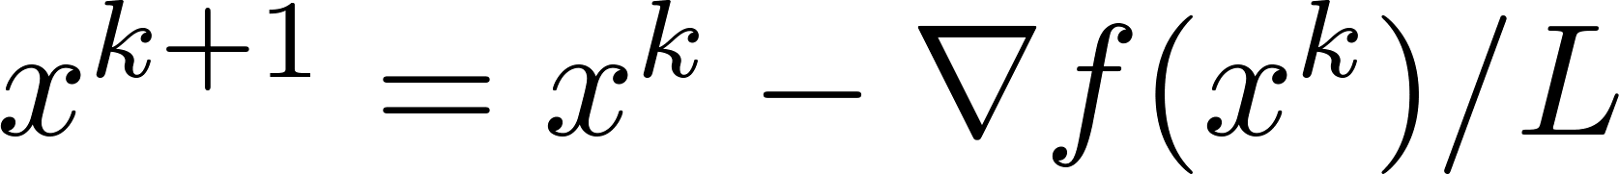
App 1: Lipschitz Gradient Surrogate
is L-smooth (differentiable + L-Lipschitz gradient).
Minimizing yields a gradient descent step:

Slide 16
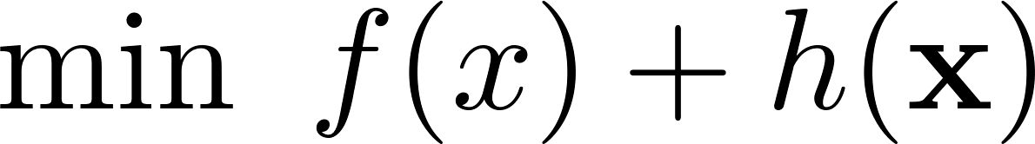
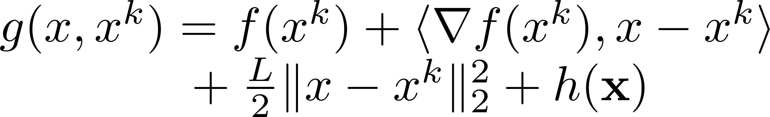
App 2: Proximal Gradient Surrogate
By Lipschitz Condition:
Minimizing g yields a gradient descent step:

Slide 17
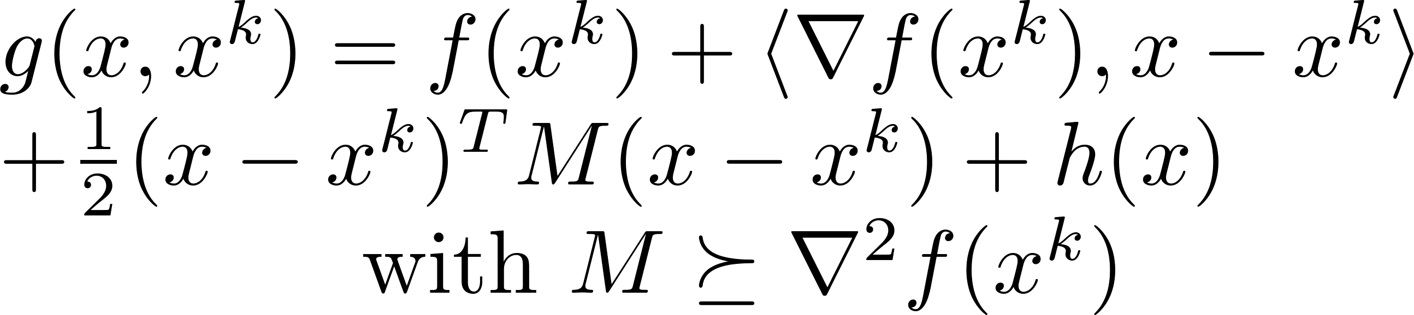
App 3: Quadratic Surrogate
Second Order Upper Bound

Slide 18
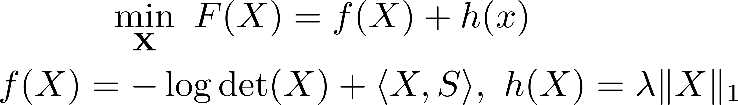
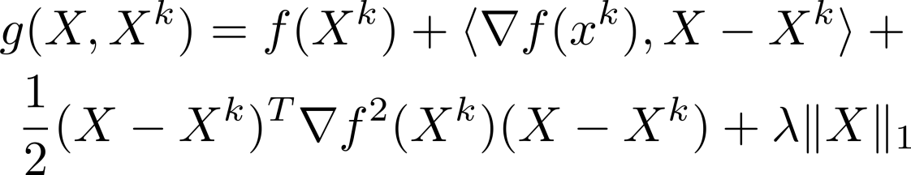
App 3: Quadratic Surrogate
Sparse Inverse Covariance Estimation
Cho-Jui Hsieh et al. Quadratic Approximation for Sparse Inverse Covariance Estimation. JMLR 2014.

Slide 19
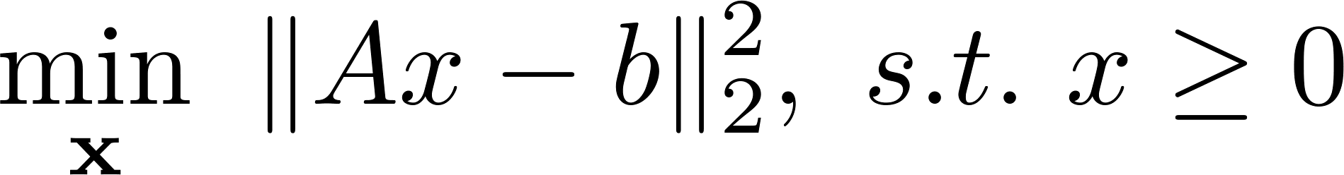
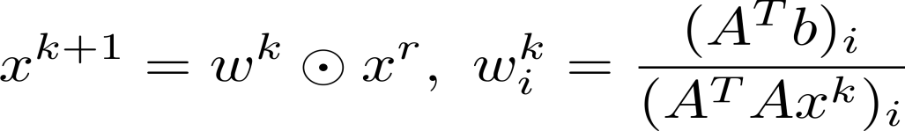
App 3: Quadratic Surrogate
Nonnegative Least Square Problem:
A simple multiplicative updating algorithm
(start from strictly positive):
Lee, Daniel D., and H. Sebastian Seung. "Algorithms for non-negative matrix factorization." NIPS, 2001.

Slide 20
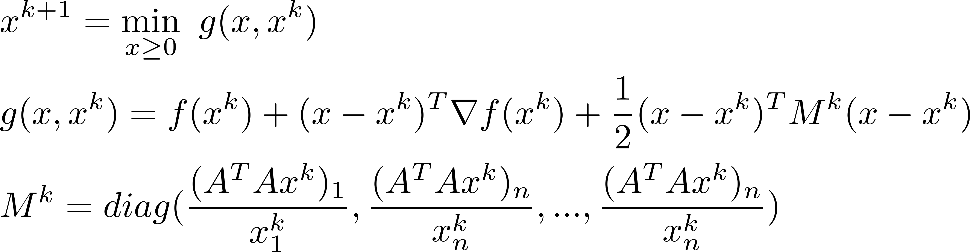
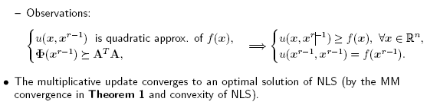
App 3: Quadratic Surrogate
MM interpretation:

Slide 21
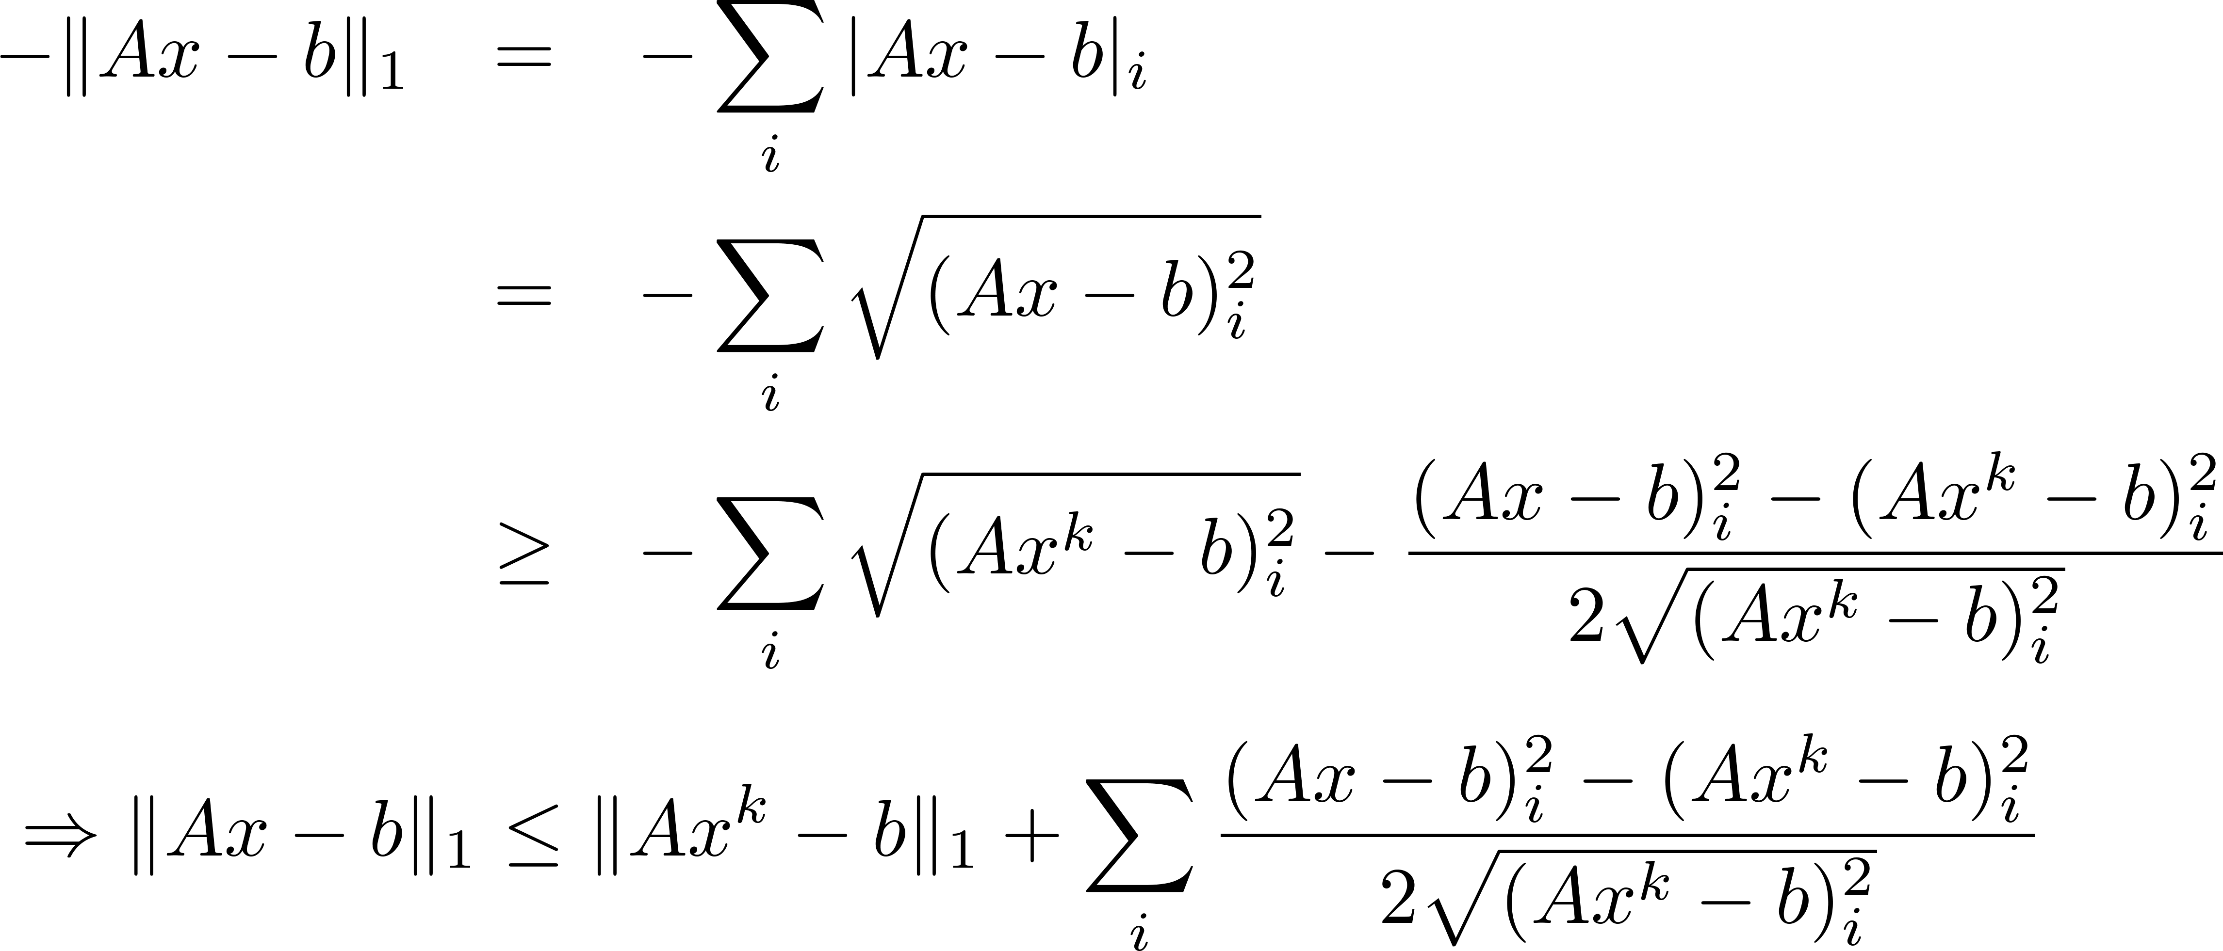
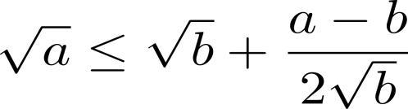
App 4: Convex Function Surrogate
L1 norm Minimization

Slide 22
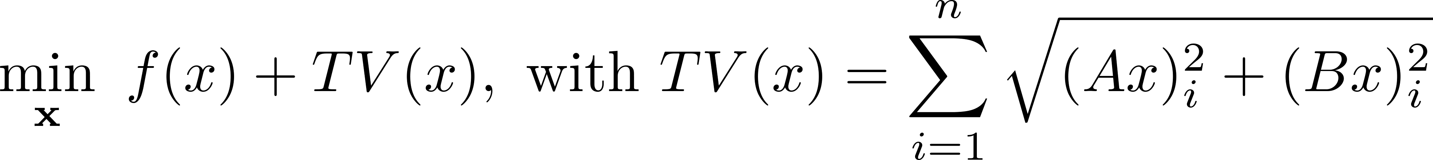
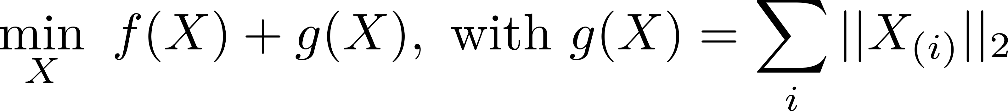
TV Norm Optimization L21 norm Minimization
App 4: Convex Function Surrogate
Other Nonsmooth Norm Minimization
Efficient and Robust Feature Selection via Joint L12-Norms Minimization. NIPS 2010.

Slide 23
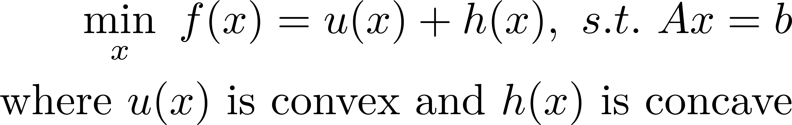
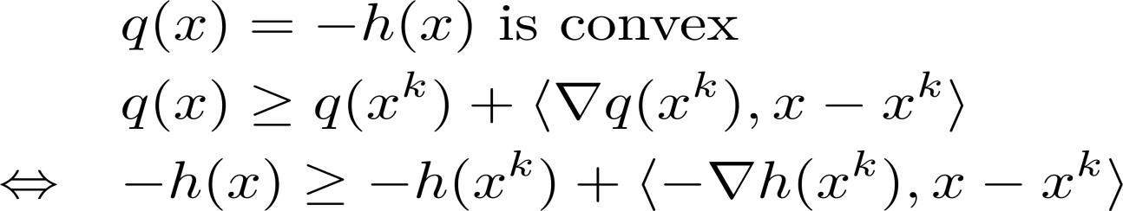
App 5: DC Programming Surrogate
Non-convex optimization
Convex Upper Bound
DC Iteration Scheme

Slide 24
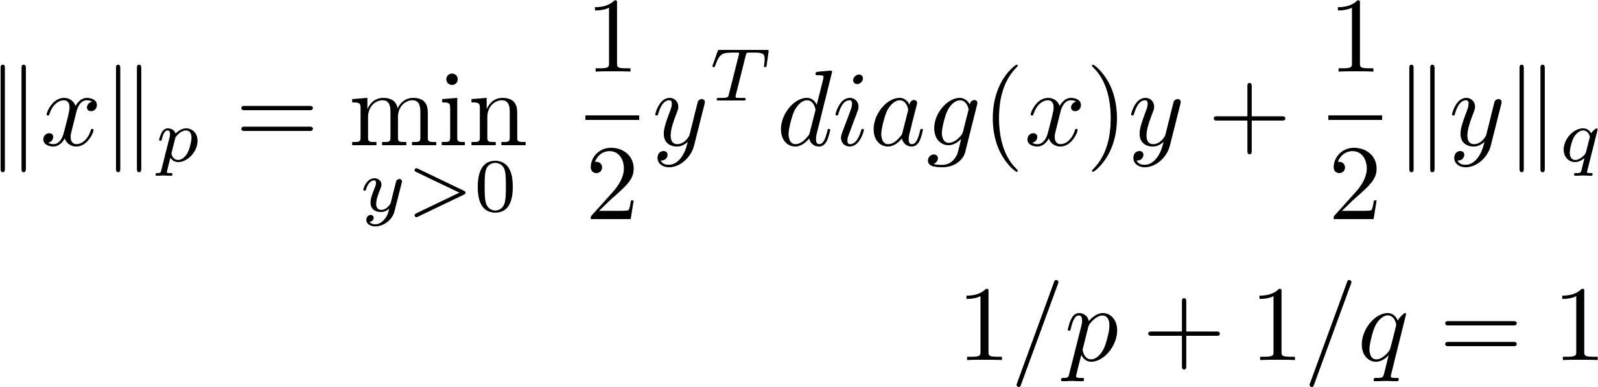
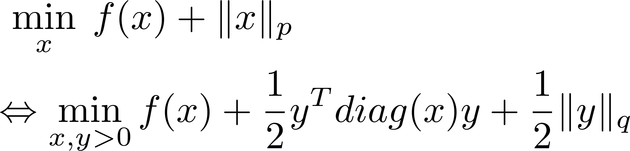
App 6: Variational Surrogate
Notes:
||y||_p = min_{z>0} 0.5 y'diag(z)y + 0.5 ||z||_q

Slide 25
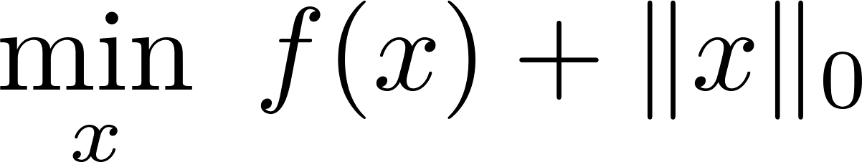
App 6: Variational Surrogate
L0 Norm MPEC reformulation
Solve at each iteration the following OP:

Slide 26
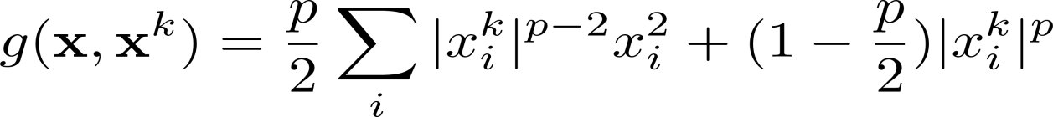
App 6: Variational Surrogate
Sparse generalized eigenvalue problem
Solve at each iteration the following OP:

Slide 27
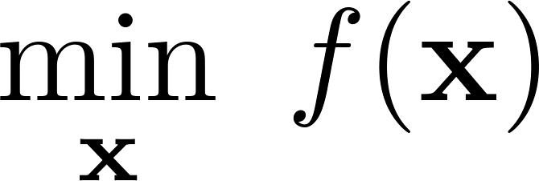
App 7: Cubic Approximation
Nesterov, Yurii, and Boris T. Polyak. "Cubic regularization of Newton method and its global performance." Mathematical Programming 108.1 (2006): 177-205.

Slide 28
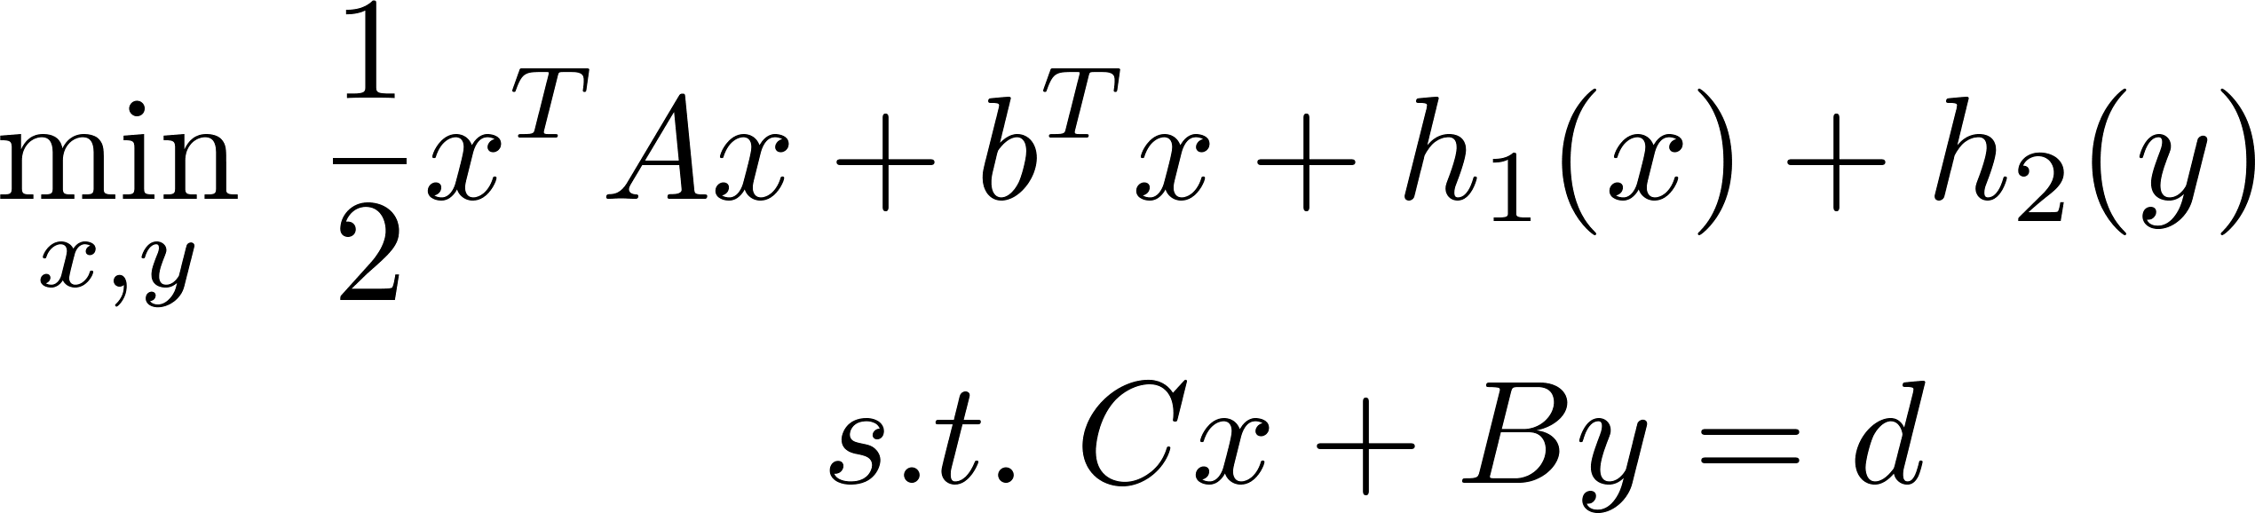
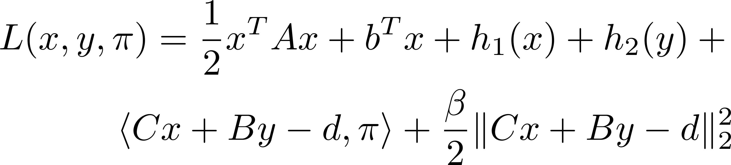
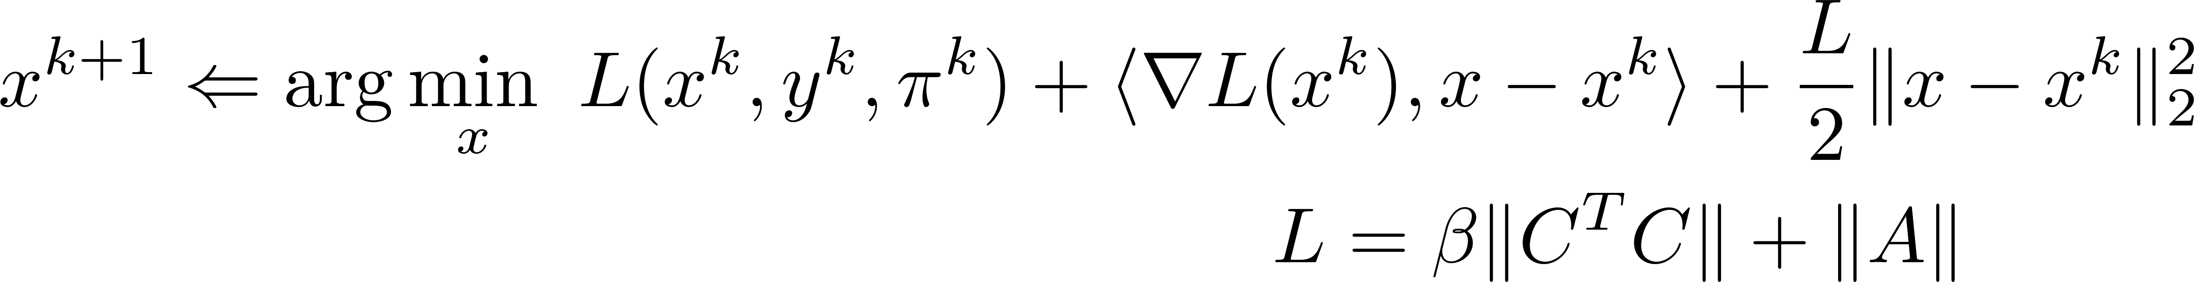
App 8: Linear / Majorized ADMM

Slide 29
References
Y. Sun, et al. Majorization-Minimization Algorithms in Signal Processing, Communications, and Machine Learning, IEEE Trans. Signal Process, 2016.
Mairal, Julien. Incremental majorization-minimization optimization with application to large-scale machine learning. SIAM Journal on Optimization 25.2 (2015): 829-855.
Zhang, Zhihua, James T. Kwok, and Dit-Yan Yeung. Surrogate maximization/minimization algorithms and extensions. Machine Learning 69.1 (2007): 1-33.
Lange, Kenneth, David R. Hunter, and Ilsoon Yang. Optimization transfer using surrogate objective functions. Journal of computational and graphical statistics 9.1 (2000): 1-20.
D. R. Hunter, et al. A Tutorial on MM Algorithms, Amer. Statistician, 2004.
M. Razaviyayn, et al. A Unified Convergence Analysis of Block Successive Minimization Methods for Nonsmooth Optimization, SIOPT, 2013.
G. Scutari, et al. Decomposition by Partial Linearization: Parallel Optimization of Multi-Agent Systems, IEEE Trans. Signal Process, 2014.

